Slide 1
Machine Learning Techniques For Predicting Over Rainfall

Slide 2
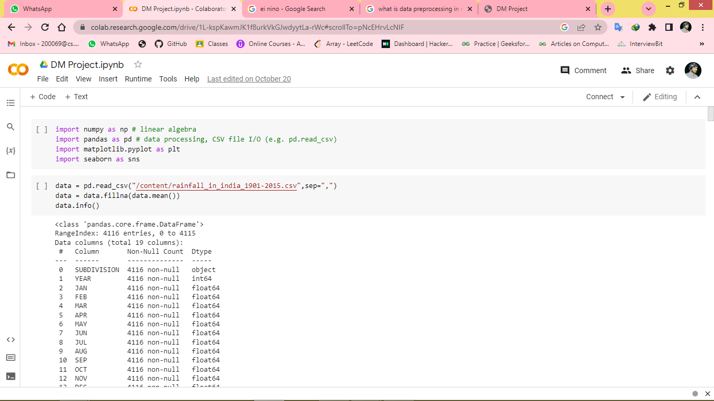
Data Processing , Libraries & CSV Reading
Fill the missing values with the mean

Slide 3
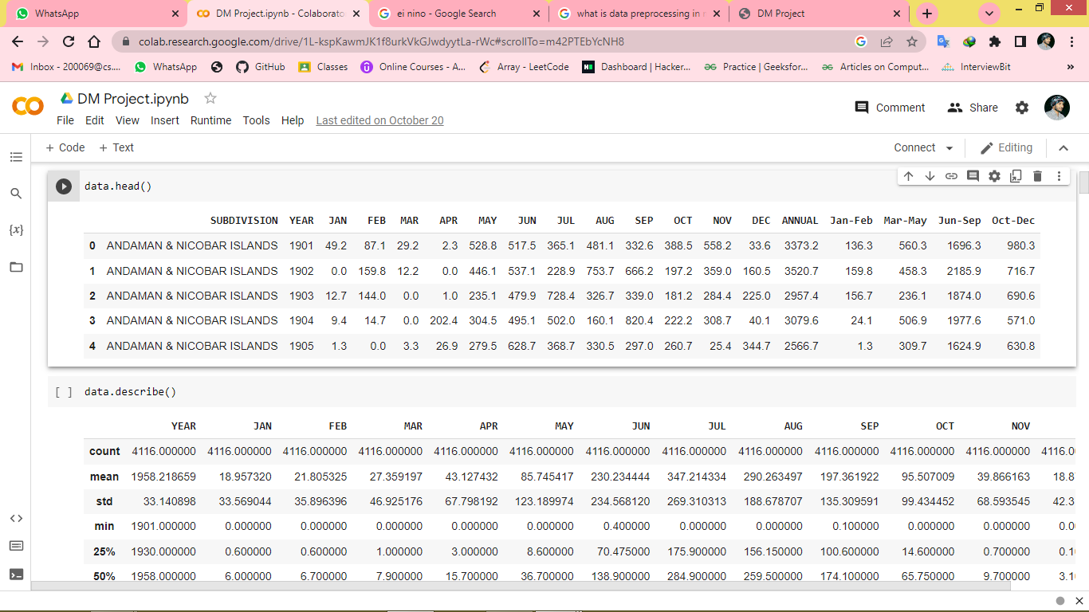
Data has 36 sub divisions and 19 attributes (individual months, annual, combinations of 3 consecutive months).
For some of the subdivisions data is from 1950 to 2015.
All the attributes has the sum of amount of rainfall in mm.

Slide 4
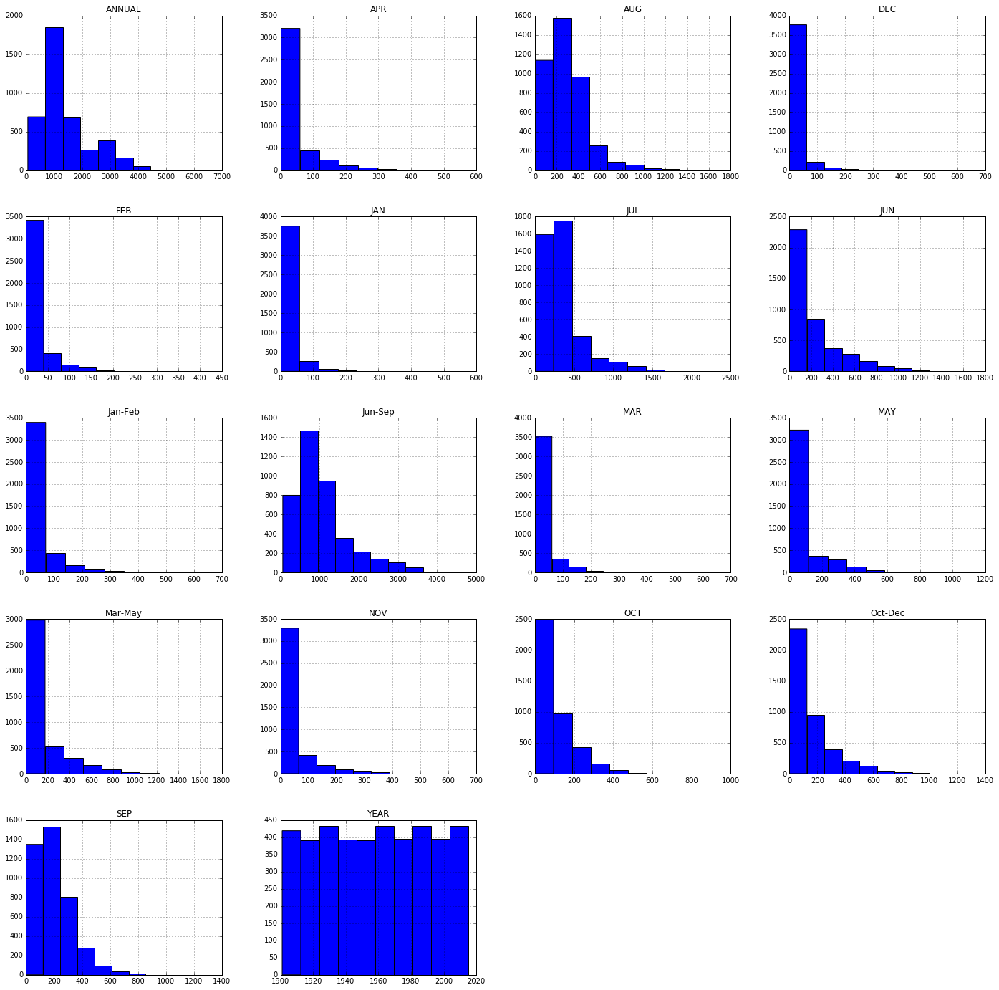

Slide 5
Observations :
Above histograms show the distribution of rainfall over months.
Observed increase in amount of rainfall over months July, August, September.

Slide 6
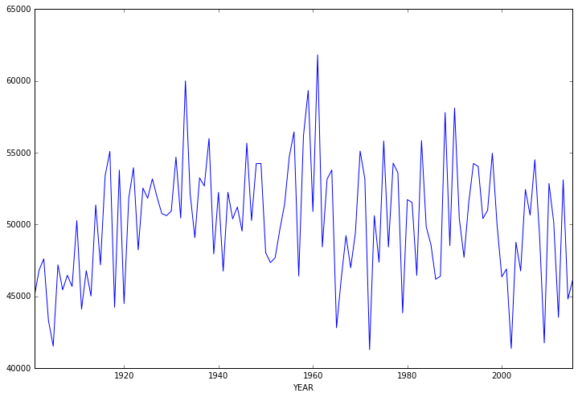
data.groupby("YEAR").sum()['ANNUAL'].plot(figsize=(12,8));

Slide 7
Observations
Shows distribution of rainfall over years.
Observed high amount of rainfall in 1950s.

Slide 8
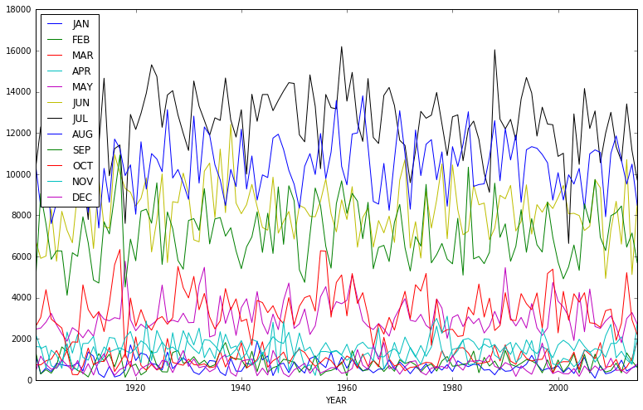
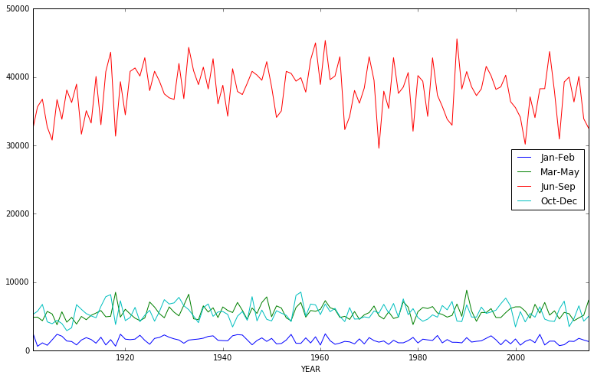
data[['YEAR', 'JAN', 'FEB', 'MAR', 'APR', 'MAY', 'JUN', 'JUL', 'AUG', 'SEP', 'OCT', 'NOV', 'DEC']].groupby("YEAR").sum().plot(figsize=(13,8));
data[['YEAR','Jan-Feb', 'Mar-May',
'Jun-Sep', 'Oct-Dec']].groupby("YEAR").sum().plot(figsize=(13,8));

Slide 9
Observations
The above two graphs show the distribution of rainfall over months.
The graphs clearly shows that amount of rainfall in high in the months july, aug, sep which is monsoon season in India.

Slide 10
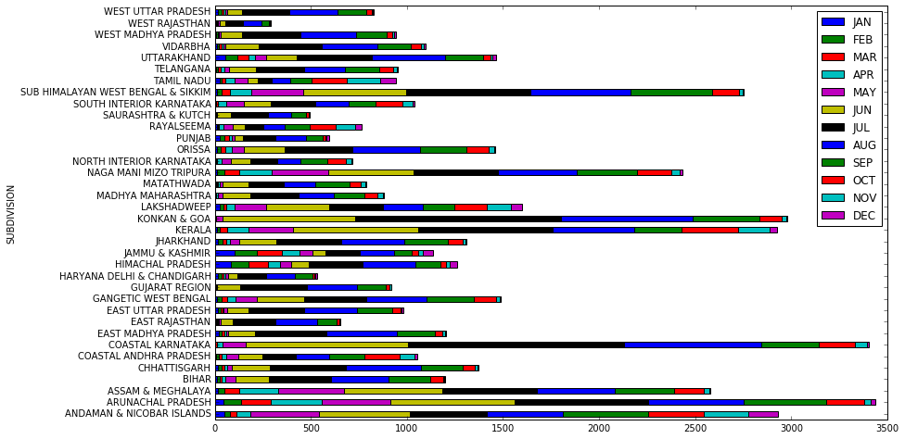
data[['SUBDIVISION', 'JAN', 'FEB', 'MAR', 'APR', 'MAY', 'JUN', 'JUL','AUG', 'SEP', 'OCT', 'NOV', 'DEC']].groupby("SUBDIVISION").mean().plot.barh(stacked=True,figsize=(13,8));

Slide 11
data[['SUBDIVISION', 'JAN', 'FEB', 'MAR', 'APR', 'MAY', 'JUN', 'JUL','AUG', 'SEP', 'OCT', 'NOV', 'DEC']].groupby("SUBDIVISION").mean().plot.barh(stacked=True,figsize=(13,8));

Slide 12
Observations
Above two graphs shows that the amount of rainfall is reasonably good in the months of march, april, may in eastern India.

Slide 13
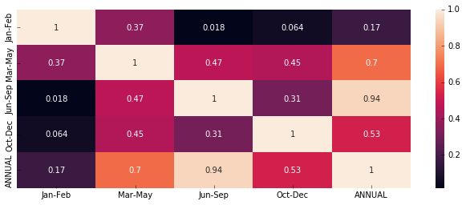
Heap Map creation

Slide 14
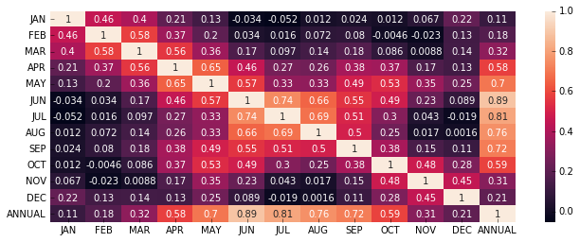

Slide 15
Observations
Heat Map shows the co-relation(dependency) betwenn the amounts of rainfall over months.
From above it is clear that if amount of rainfall is high in the months of july, august, september then the amount of rainfall will be high annually.
It is also obwserved that if amount of rainfall in good in the months of october, november, december then the rainfall is going to b good in the overall year.

Slide 16
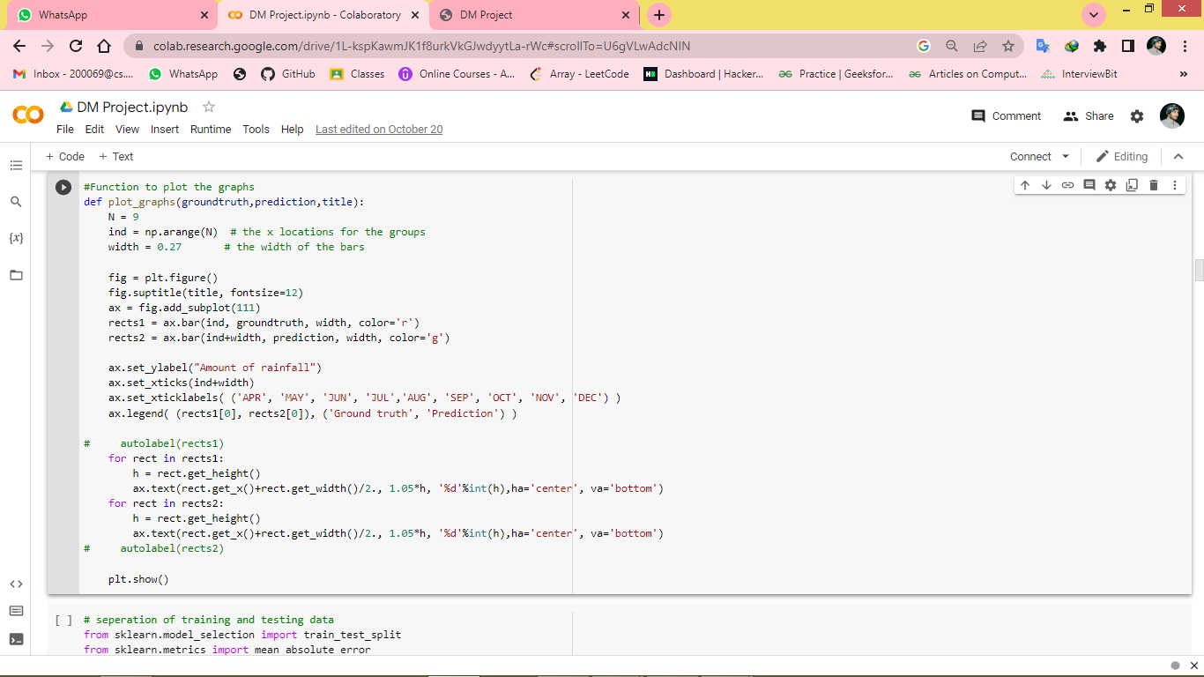
Function to plot Graph

Slide 17
Predictions
• For prediction we formatted data in the way, given the rainfall in the last three months we try to predict the rainfall in the next consecutive month.
• For all the experiments we used 80:20 training and test ratio.
– Linear regression
– SVR
– Artificial neural nets
Testing metrics: We used Mean absolute error to train the models.
We also shown the amount of rainfall actually and predicted with the histogram plots.
We did two types of trainings once training on complete dataset and other with training with only telangana data
All means are standard deviation observations are written, first one represents ground truth, second one represents predictions.

Slide 18
Groundtruth Predicted
MEAN 2005
121.2111111111111 134.68699821349804
Standard deviation 2005
123.77066107608005 90.86310230416437
MEAN 2010
139.93333333333334 144.80501326515912
Standard deviation 2010
135.71320250194282 95.94931363601727
MEAN 2015
88.52222222222223 119.64752006738826
Standard deviation 2015
86.62446123324875 62.363553701633734

Slide 19
